Slide 1
MACHINE LEARNING PROJECT DATA ANALYSIS ON TITANIC DATASET
BY SIMRAN CHAWLA

Slide 2
PROJECT DESCRIPTION
This repository contains a machine learning project for predicting survival of passengers who travelled on Titanic Ship in 1912.
The sinking of the RMS Titanic is one of the most infamous shipwrecks in history. On April 15, 1912, during her maiden voyage, the Titanic sank after colliding with an iceberg, killing 1502 out of 2224 passengers and crew. This sensational tragedy shocked the international community and led to better safety regulations for ships.
One of the reasons that the shipwreck led to such loss of life was that there were not enough lifeboats for the passengers and crew. Although there was some element of luck involved in surviving the sinking, some groups of people were more likely to survive than others, such as women, children, and the upper-class.
This project analyses which people were likely to survive. In particular, tools of machine learning have been used to predict which passengers survived the tragedy.

Slide 3
SOFTWARE USED
Tools used
Anaconda Navigator – 1.9.6
Jupyter Notebook – 6.0.3
Library used
Pandas
Numpy
Sklearn

Slide 4
This project has been made in Python 3 on Jupyter Notebook. It uses various data processing, visualization and machine learning packages such as numpy, pandas. which should be installed if the code is run on a local machine.
The project uses a 5 step process (general procedure) for its predicting task.

Slide 5
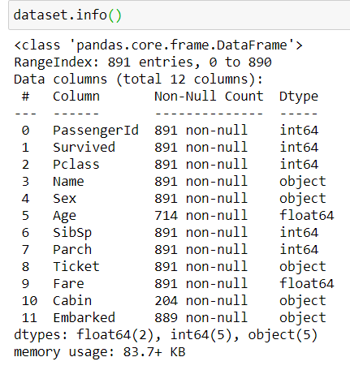
1. LOADING OF DATA
Loading the dataset and analyze it. Finding the shape
and information about the dataset.

Slide 6
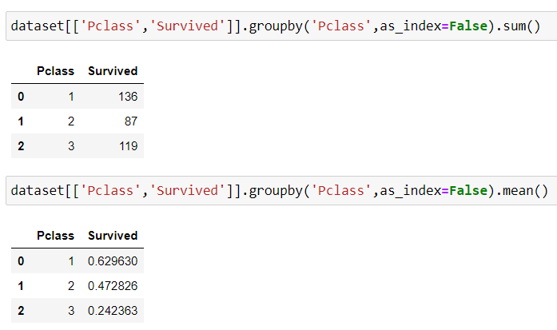
2. FINDING RELATIONSHIP BETWEEN FEATURES AND LABELS
Finding the relation between target
column which is “Survived” and
other features by counting there
number of values and calculating
mean to calculate the percentage
of survival for each passenger.

Slide 7
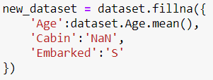
3. MISSING VALUES
Finding the number of missing values in each column. In numerical columns the missing values are replaced by mean and in categorical columns the missing values are replaced by “NaN”.

Slide 8
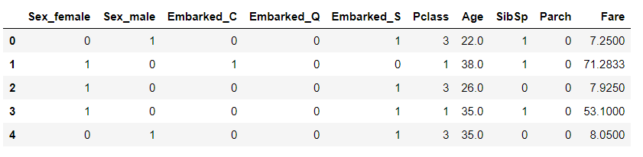
4. BUILD THE MODEL
We build the model by selecting features used for prediction, changing categorical data to one-hot encode, scale them and split them to train and test dataset.

Slide 9

5. PREDICTIONS
LOGISTIC REGRESSION
Logistic regression is a statistical model that in its basic form uses a logistic function to model a binary dependent variable, although many more complex extensions exist. In regression analysis, logistic regression (or logit regression) is estimating the parameters of a logistic model.
By predicting using this algorithm, the confusion matrix is
in which 141 out of 208 predictions are correct and its accuracy score is 0.7877094972067039.

Slide 10

5.PREDICTIONS
RANDOM FOREST
Random forests or random decision forests are an ensemble learning method for classification, regression and other tasks that operate by constructing a multitude of decision trees at training time and outputting the class that is the mode of the classes or mean prediction of the individual trees.
By predicting using this algorithm, the confusion matrix is
in which 141 out of 208 predictions are correct and its accuracy score is 0.7877094972067039.

Slide 11

5. PRESDICTIONS
K-NEAREST NEIGHBOR CLASSIFICATION
The k-nearest neighbors (KNN) algorithm is a simple, easy-to-implement supervised machine learning algorithm that can be used to solve both classification and regression problems.
By predicting using this algorithm, the confusion matrix is
in which 130 out of 208 predictions are correct and its accuracy score is 0.7262569832402235.

Slide 12
CONCLUSIONS
Algorithm logistic regression and random forest are more accurate than KNN classifier as the accuracy score of logistic regression and random forest are greater than KNN classifier.
Women, children and first class passenger as well as people with small family had a better chance of survival. The Embarked doesn’t seem to have an effect as the percentage are in line with the amount of people embarked from each port.
And I am getting accuracy of 78.77%

Slide 13
THANK YOU

